Slide 1
Chapter 7
Shinto

Slide 2
Learning Objectives
7.1 Explain the importance of the natural world in the roots of “Shinto.”
7.2 Outline the elements of Confucianism and Buddhism that have been blended with Shinto.
7.3 Discuss the reasons why Shinto has been so closely tied to Japanese nationalism.
7.4 Define what is meant by “Sect Shinto” and give an example.
7.5 Summarize the main aspects of contemporary Shinto.

Slide 3
“People come to shrines because these are sacred places from ancient times where people have come to pray. And other people want to go where people are gathered.”
Hitoshi Iwasaki
Notes:
Hitoshi Iwasaki, personal communication, April 1990.

Slide 4
Introduction
The goals of the chapter are:
(1) to describe the origins and major characteristics of Shinto;
(2) to describe the origins and major characteristics of Shinto;
(3) to illustrate some of the influence of Buddhism and Confucianism on this native religion; and
(4) to highlight some contemporary issues within Shinto.

Slide 5
Introduction
“Shinto” is an overarching label applied to various ways of honoring the spirits in nature, so named to distinguish such practices from Buddhism and other religions brought from outside Japan.
Native to Japan, Shinto is not a single self-conscious religious tradition but rather a descriptor of ways of honoring nature, ancestors, folk religion, local rites, festivals, imperial myths, nationalism, and universalistic teachings.
It is an indigenous tradition, which in modern practice may be combined with elements of Confucianism, Buddhism, and Christianity.
It has also been associated with imperial power and worship of the emperor.

Slide 6
7.1 The roots of “Shinto”
The label Shinto derives from the words shin (divine being) and do (way).
The two major written Shinto chronicles, the Kojiki (compiled in 712 CE) and the Nihongi (compiled in 720 CE), appear to be influenced by Buddhist, Confucian, Korean, and Chinese thought.
These chronicles combine myths, historical facts, politics, and literature and are generally not thought of as sacred scriptures.
During the Tokugawa period (1600–1868) and the Meiji Restoration (1868), Imperial efforts were also made to define a specifically Japanese religion.

Slide 7
7.1 The roots of “Shinto”
Shinto does not have a known founder, nor does it have an orthodox sacred scripture, or an explicit ethical code.
Its historical origins appear to lie in the practice of individual clans worshiping a deity as their ancestor, along with worship of other unseen beings and natural forces.
It was not identified with a specific name until Buddhism spread to Japan during the sixth century CE. After that time, this indigenous sacred way sought to distinguish itself from Buddhism. Until that necessity occurred, this sacred path was simply understood as the proper attitude with which to live one’s life.

Slide 8
7.1 Kinship with nature
Natural beauty and symmetry have always been important in Japan.
People organized their lives around the seasons.
Mount Fuji is honored as an embodiment of the divine power that forced the land up through the sea.
Reverence for nature is expressed in the arts.
Industrialization and urbanization have challenged the kinship with nature insofar as they have blighted much of the natural land of Japan.

Slide 9
7.1 Relationships with the kami
The most ancient forms of spirituality in Japan were probably linked to the spirits perceived in the natural world—the kami.
The sacred is understood to be both immanent and transcendent; the divine originated as one essence. This essence gave birth to many kami or spirits, which organized the material world.
The Amatsu kami created Amaterasu, the goddess of the sun, and also created the ancestors of the Japanese.

Slide 10
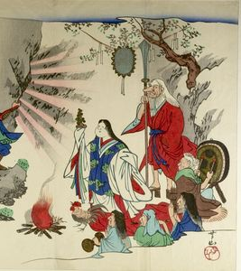
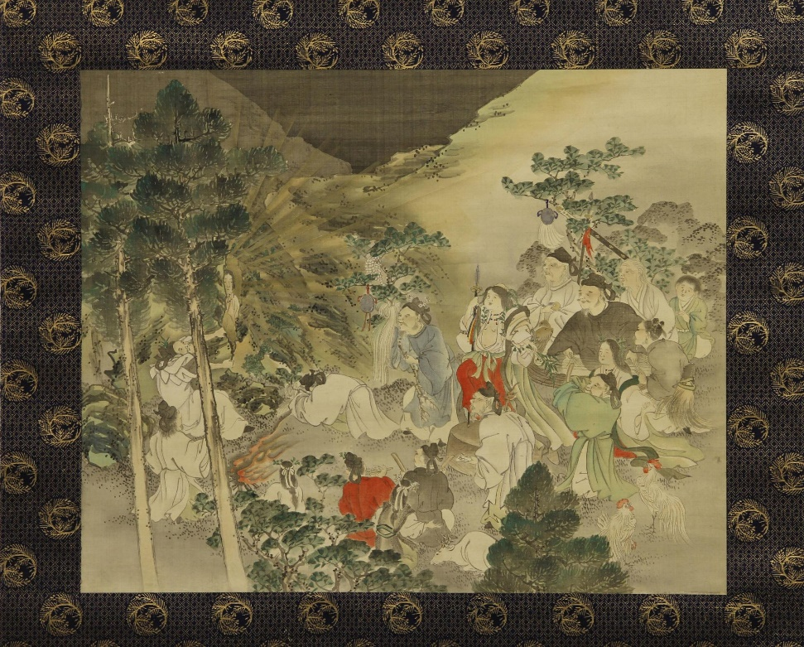
Sun Goddess Amaterasu emerges from cave
Notes:
Description
Painting, hanging scroll. Tajikarao-no-kami having dragged aside the rock, the sun goddess Amaterasu emerges from the cave, with Okame dancing upon a drum outside, surrounded by other deities. Ink and colour on silk.
Shoshin gakuso koki o sasou 諸神奏楽誘皇輝 (Deities Perform Music to Tempt the Sun Goddess) (Deities Perform Music to Tempt the Sun Goddess)Series: Series: Honcho nenreki zue, ni 本朝年歴図会、二 (Illustrations of the Annals of Japan, No. 2) (Illustrations of the Annals of Japan, No. 2)

Slide 11
7.1 Shrines
There are some one hundred thousand public shrines in Japan honoring the kami.
Some shrines are dedicated to kami who protect the local area or have special responsibilities, such as healing or protecting crops.
• The greatest number of shrines is dedicated to Inari, the god of rice, whose messengers are foxes.
• Kamikaze, meaning divine wind, became an aspect of Amaterasu and, later, a symbol of divine protection of Japan by the kami.

Slide 12
7.1 Relationships with the kami
Kami reside in beautiful and powerful places, and may also appear in abstract forms. They can exist in rocks, trees, and other forms of nature, but also in processes such as reproduction and creative imagination.
For much of Japanese history, the emperor was revered as a kami.
To follow the kami is to bring one’s life into harmony with nature, or kannagara, “the way or nature of the kami.”

Slide 13
Shinto
“Shinto” refers to collection of local traditions.
Not a single self-conscious religion
An overarching label applied to:
A way of honoring spirits in nature
Ancestor veneration
“Folk” religious practices such as divination and taboos, local rites and festivals, imperial myths, nationalism, and universalistic teachings.
Notes:
an overarching label applied to ways of honoring the spirits in nature, ancestor veneration, “folk” religious practices such as divination and taboos, local rites and festivals, imperial myths, nationalism, and universalistic teachings.

Slide 14
Shinto
Japanese religion combining practices
Confucian ethics
Buddhist and Christian understandings of afterlife
Traditional veneration of ancestors and spirits
“Shinto” lead people to worship and pray for blessings at shrines and participate in popular cultural festival
Religious participation is high, but affiliation to institutional religions is low
Notes:
While almost ninety percent of the people annually visit their ancestors’ graves, seventy-five percent have either a Buddhist or a Shinto altar in their home, seventy percent visit a Shinto shrine during the first three days of the New Year, more than sixty percent believe in an “unseen higher power,” almost fifty percent say they believe in deities or buddhas, and more than thirty percent engage a Shinto priest to purify new cars or building plots, only thirty percent of the population say that they belong to any institutional religion.

Slide 15

The Roots of “Shinto” (1 of 3)
Why is kinship with nature linked with Shinto?
In ancient times, individual clans apparently worshiped a particular deity as their own ancestor, along with other unseen beings and natural forces
Such worship was localized until the 8th century CE, when the term “Shinto” came into use to distinguish indigenous Japanese ways from Buddhism and other imported religions
Shinto = shin (divine being) + do (way)

Slide 16
The Roots of “Shinto” (2 of 3)
Why is kinship with nature linked with Shinto?
Shinto not easily identified as a religion in the Western sense
No single founder
No orthodox canon of sacred literature
No ethical requirements
The meanings of its rituals are unknown by many who practice them
Shinto = shin (divine being) + do (way)

Slide 17
The Roots of “Shinto”(3 of 3)
Kojiki (712 CE) and Nihongi (720 CE)
Major chronicles of Shintoism
Not uniquely Japanese, for they seem to be greatly influenced by Buddhist, Confucian, Korean, and Chinese thought
Myths, historical facts, politics, and literature
Not sacred scriptures
Aimed at conferring spiritual legitimacy on Imperial Throne
Jimmu
First emperor and founder of dynasty
Descendent of sun goddess Amaterasu
Notes:
Description
Painting, hanging scroll. Tajikarao-no-kami having dragged aside the rock, the sun goddess Amaterasu emerges from the cave, with Okame dancing upon a drum outside, surrounded by other deities. Ink and colour on silk.
Shoshin gakuso koki o sasou 諸神奏楽誘皇輝 (Deities Perform Music to Tempt the Sun Goddess) (Deities Perform Music to Tempt the Sun Goddess)Series: Series: Honcho nenreki zue, ni 本朝年歴図会、二 (Illustrations of the Annals of Japan, No. 2) (Illustrations of the Annals of Japan, No. 2)

Slide 18
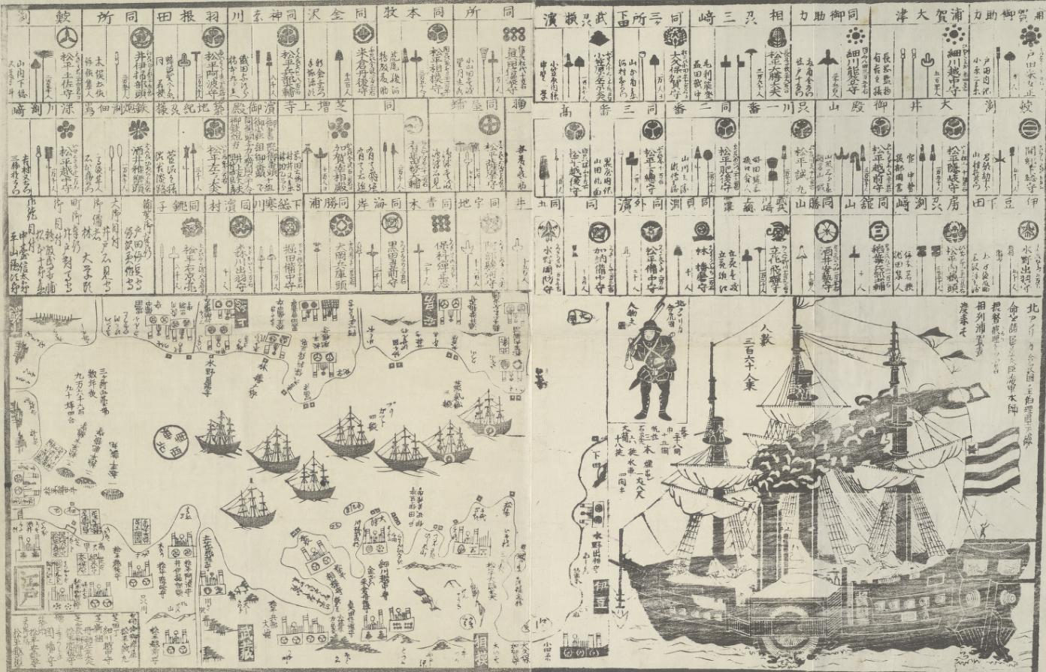
The Perry Expedition
An American diplomatic and military expedition to the Tokugawa Shogunate, involving two separate voyages by warships of the United States Navy
Took place during 1853–54
Notes:
Perry’s primary goal was to force an end to Japan’s 220-year-old policy of isolation and to open Japanese ports to American trade

Slide 19
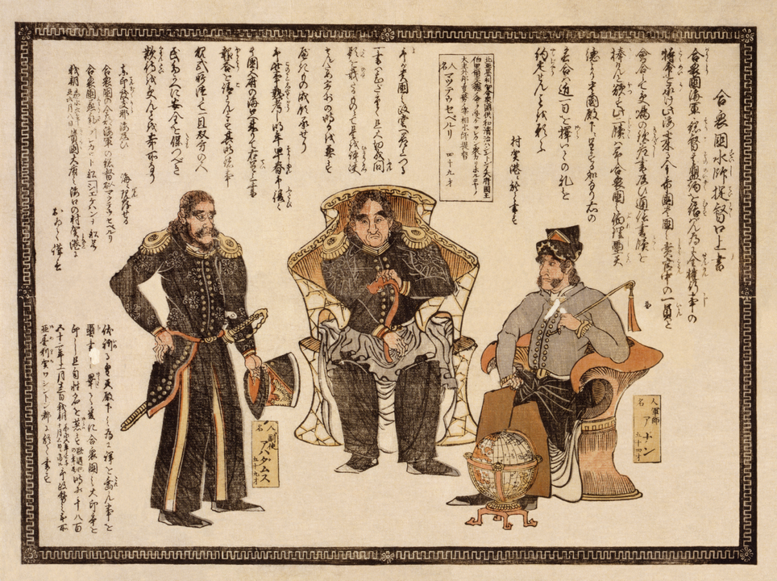
The Perry Expedition
Goals:
Exploration and surveying
Establishment of diplomatic relations and negotiation of trade agreements with various nations of the region
Opening contact with the government of Japan
Notes:
Perry’s primary goal was to force an end to Japan’s 220-year-old policy of isolation and to open Japanese ports to American trade

Slide 20
Political changes & Shinto
During the Tokugawa period in Japan (1600–1868), thinkers made effort to define the “native” Japanese religion, as opposed to foreign incursions, by collating various texts, popular practices, and myths.
1868, the Meiji Restoration brought Emperor Meiji and an imperial state apparatus into power. To confront subjugation by Western colonial powers, the Meiji regime turned to conservatism and nationalism, with emphasis on worship of the emperor.
Notes:
Description
Painting, hanging scroll. Tajikarao-no-kami having dragged aside the rock, the sun goddess Amaterasu emerges from the cave, with Okame dancing upon a drum outside, surrounded by other deities. Ink and colour on silk.
Shoshin gakuso koki o sasou 諸神奏楽誘皇輝 (Deities Perform Music to Tempt the Sun Goddess) (Deities Perform Music to Tempt the Sun Goddess)Series: Series: Honcho nenreki zue, ni 本朝年歴図会、二 (Illustrations of the Annals of Japan, No. 2) (Illustrations of the Annals of Japan, No. 2)

Slide 21
Political changes & Shinto
The extreme nationalism fostered by this trend, supported by religious veneration of the emperor, came to an end with World War II, with the victors forcing Japan to separate religion and politics.
Now the authorities who run the many shrines in Japan are again promoting the idea that Shinto is a religion unto itself, native to Japan.
Notes:
Description
Painting, hanging scroll. Tajikarao-no-kami having dragged aside the rock, the sun goddess Amaterasu emerges from the cave, with Okame dancing upon a drum outside, surrounded by other deities. Ink and colour on silk.
Shoshin gakuso koki o sasou 諸神奏楽誘皇輝 (Deities Perform Music to Tempt the Sun Goddess) (Deities Perform Music to Tempt the Sun Goddess)Series: Series: Honcho nenreki zue, ni 本朝年歴図会、二 (Illustrations of the Annals of Japan, No. 2) (Illustrations of the Annals of Japan, No. 2)

Slide 22
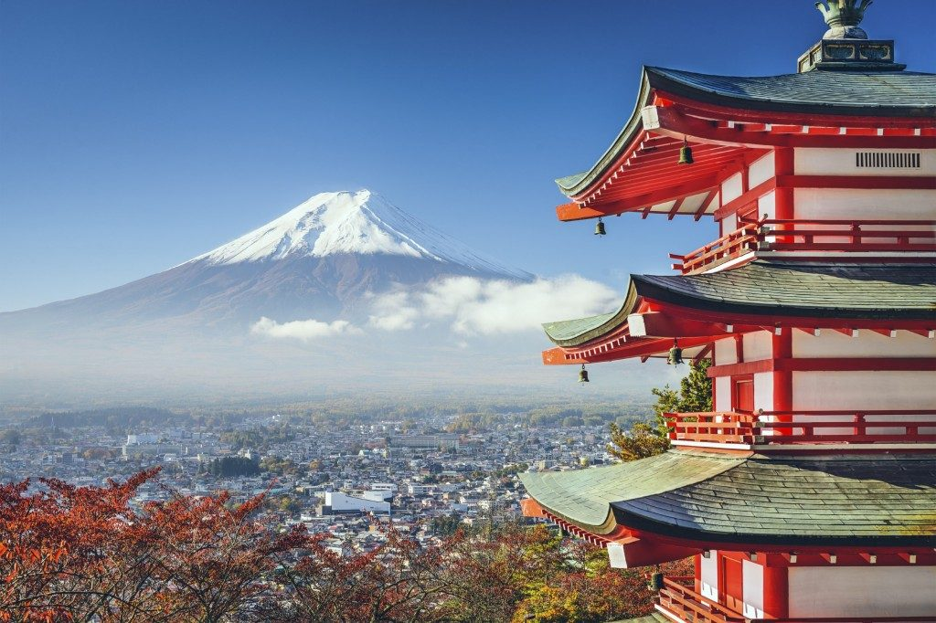
Kinship with nature
Environment is embodiment of the divine
Life organized around honoring natural world
Honoring sun, moon, and lightning in rice cultivation
Mount Fuji: embodiment of divine creation
Threat of industrialization and urbanization
Notes:
Despite industrial pollution and urbanization, Japan is still a country of exquisite natural beauty
Living close to nature, they organized their lives around the turn of the seasons, honoring the roles of the sun, moon, and lightning in their rice farming.

Slide 23
Relationships with kami
kami: spirits perceived in the natural world
Translations of “god” or “spirit” not exact
“Kami” both singular and plural
A single essence manifesting in many places
Refers to a quality
“that which is above”
Invokes wonder and awe

Slide 24
Relationships with kami
kami: spirits perceived in the natural world
Harmonize heaven and earth and guides the solar system and the cosmos.
Tend to reside in beautiful or powerful places, such as mountains, certain trees, unusual rocks, waterfalls, whirlpools, and animals
Manifest as wind, rain, and fearsome forces such as thunder, lightning, tsunamis, and earthquakes
Kami also appear in abstract forms, such as the creativity of growth and reproduction

Slide 25
Relationships with kami
Kami
Worship like other indigenous religious ways in other parts of the world
Kojiki and Nihongi
Amatsu (heavenly) kami organized material world
Stirred the ocean to create Japanese islands
Created Amaterasu (the one who illuminates the sky), the goddess of the sun
kannagara: the way of nature of the kami, another name for Shinto
Notes:
Carried on in open-air sites without buildings, but perhaps with efforts to propitiate the kami by specialists in communicating with them. Such local traditions may have been eventually institutionalized in the building of shrines in which the kami could be contacted, with priests and rituals for negotiating with them for agricultural development and evolving political structures.
his deity gave birth to many kami, two of which—the Amatsu (heavenly) kami—were told to organize the material world. Standing on the Floating Bridge of Heaven, they stirred the ocean with a jeweled spear.

Slide 26
Relationships with kami
Natural Religion is the spontaneous awareness of the Divine that can be found in any culture. … The Spirit of Great Nature may be a flower, may be the beauty of the mountains, the pure snow, the soft rains or the gentle breeze. Kannagara means being in communion with these forms of beauty and so with the highest level of experiences of life.
When people respond to the silent and provocative beauty of the natural order, they are aware of kannagara. When they respond in life in a similar way, by following ways “according to the kami,” they are expressing kannagara in their lives. They are living according to the natural flow of the universe and will benefit and develop by so doing.
Yukitaka Yamamoto, ninety-sixth Chief Priest of the Tsubaki Grand Shrine
Notes:
Carried on in open-air sites without buildings, but perhaps with efforts to propitiate the kami by specialists in communicating with them. Such local traditions may have been eventually institutionalized in the building of shrines in which the kami could be contacted, with priests and rituals for negotiating with them for agricultural development and evolving political structures.
his deity gave birth to many kami, two of which—the Amatsu (heavenly) kami—were told to organize the material world. Standing on the Floating Bridge of Heaven, they stirred the ocean with a jeweled spear.

Slide 27
Shrines
No shrines in early Shinto
Buddhist influences in 6th century CE led to shrines
>100,000 shrines in Japan
Small as beehives or elaborate temple complexes covering thousands of acres
Some honor kami protecting the local area
Others honor kami with special responsibilities, such as healing or protecting crops from insects
Local shrines are situated on sites thought to have been chosen by the kami for their sacred atmosphere.
At one time, every community had its own guardian kami.

Slide 28
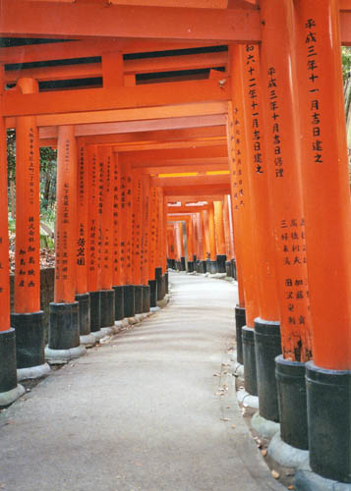
Inari
Inari
Greatest number of shrines
The kami of rice
Fox messengers
Associated with good harvests but are now frequented by people seeking success in business of any sort

Slide 29
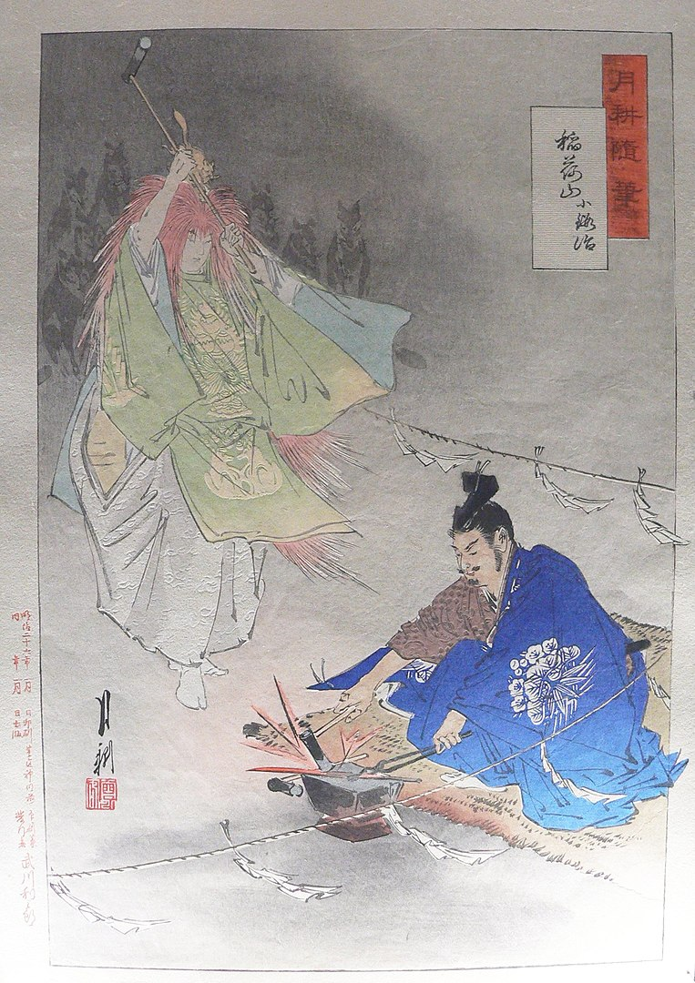
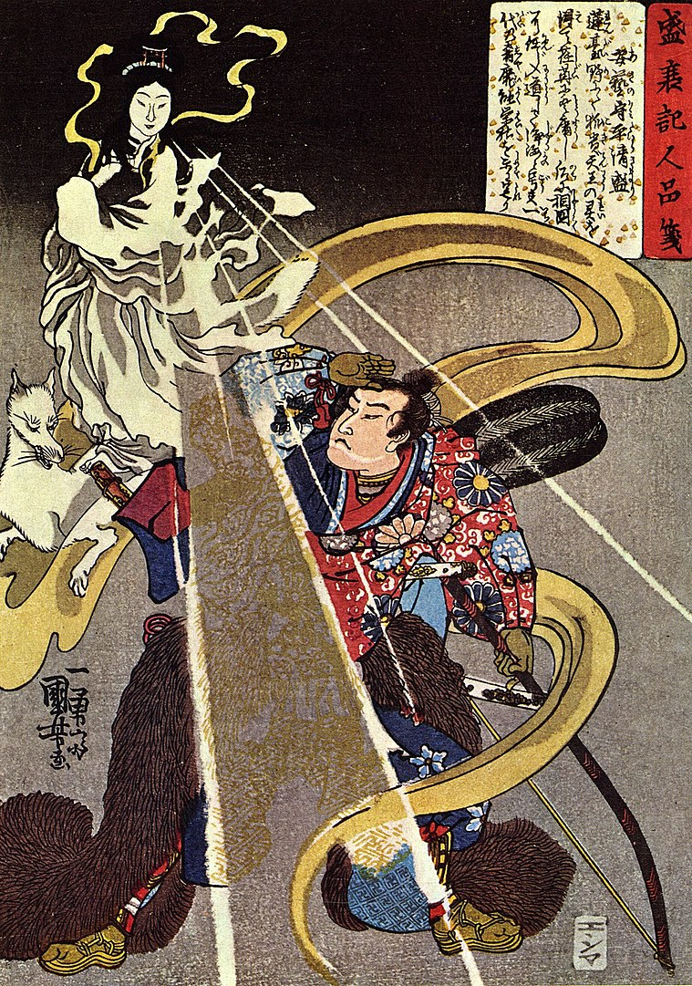
Inari

Slide 30
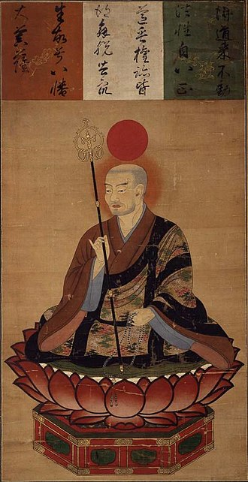
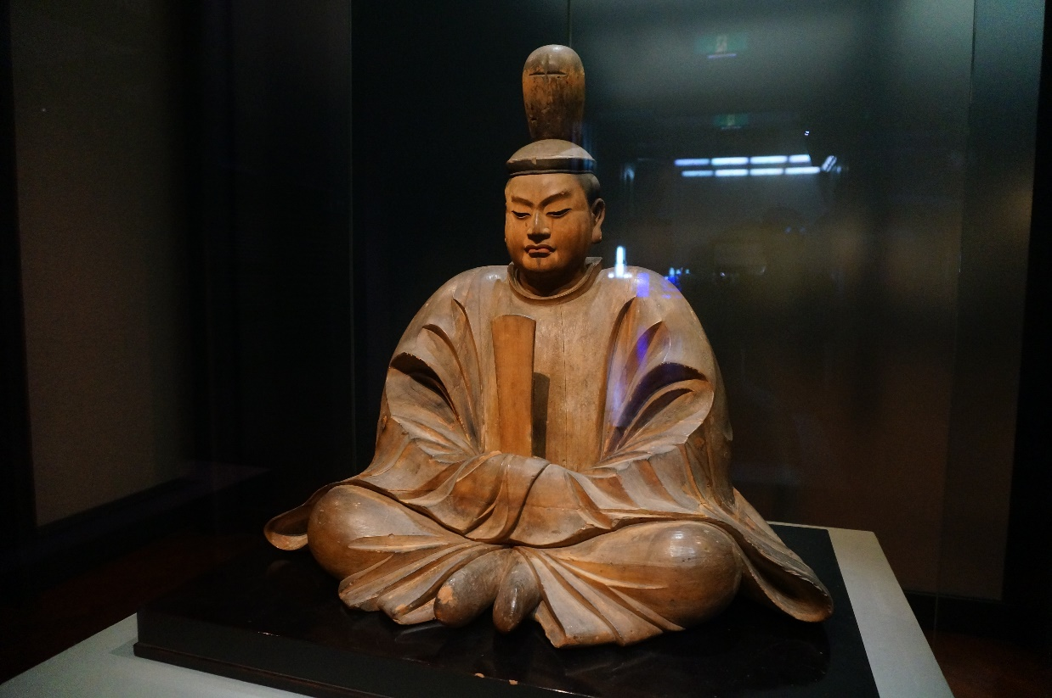
Hachiman - Kami of War

Slide 31
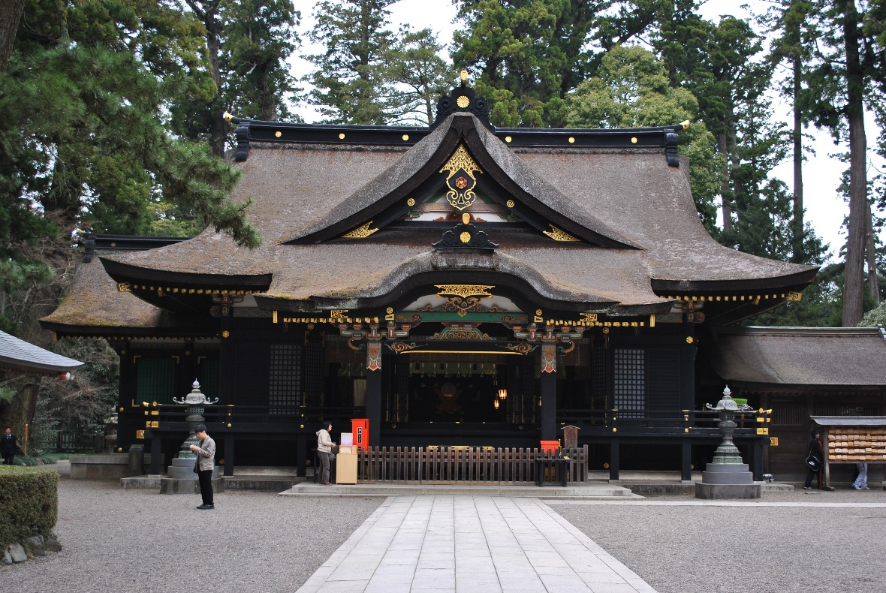
Ise Shrine
Complex with more than 100 shrines
Constructed in 690 CE
Main shrine to Amaterasu; contains the Sacred Mirror
Imperial family responsible for administration and rituals

Slide 32
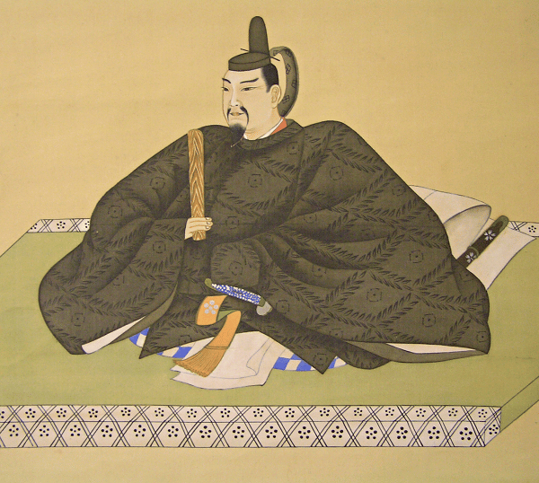
Tenjin
Shrines dedicated to the kami of a 9th century CE scholar
Raijin or thunder god
Deity of poetry, scholarship, and letters
Popular among students getting ready for exams
Shinto-Buddhist rite which hasn’t been held since 1467 to appease him because of Covid

Slide 33
Shrines
kamikaze: “divine wind,” an aspect of Amaterasu
Marking sacred space:
Torii: tall gate-frames
Walls
Streams with bridges
Statues of guardian animals
Ropes
Notes:
The word “kamikaze,” meaning “divine wind,” became one of the aspects of Amaterasu and later, a symbol of divine protection of Japan by the kami. The earliest places of worship were probably sacred trees or groves, perhaps with some enclosure to demarcate the sacred area. Shrine complexes that developed later also have some way of indicating where sacred space begins: tall gate-frames, known as torii; walls; or streams with bridges, which must be crossed to enter the holy precinct of the kami. Water is a purifying influence, and stone water troughs with bamboo dippers are also provided for washing one’s mouth and hands before passing through the torii. Statues of guardian animals may further protect the area from evil intrusions, as do ropes with pendants hanging down.

Slide 34
Shrines
Water is a purifying influence, and stone water troughs with bamboo dippers are also provided for washing one’s mouth and hands before passing through the torii
Kami invited to dwell in an object
Shinto is strongly iconoclast (opposed to images of the divine)
Notes:
The earliest places of worship were probably sacred trees or groves, perhaps with some enclosure to demarcate the sacred area. Shrine complexes that developed later also have some way of indicating where sacred space begins: tall gate-frames, known as torii; walls; or streams with bridges, which must be crossed to enter the holy precinct of the kami. Water is a purifying influence, and stone water troughs with bamboo dippers are also provided for washing one’s mouth and hands before passing through the torii. Statues of guardian animals may further protect the area from evil intrusions, as do ropes with pendants hanging down.

Slide 35
Shrines
May be an area for public worship
Visitors may:
throw coins into an offering box
stand praying with bowed head,
clap their hands twice, and pull a rope attached to a suspended metal gourd that clatters to set up vibrations in the air
to attract the kami so that one can communicate with them and also perhaps chasing away evil spirits

Slide 36
Shrines
Beyond the public space may be a roofed structure where priests conduct rites
Beyond that is the sacred sanctuary, which is entered only by the high priest
Here the spirit of the kami is invited to dwell within a special natural object or perhaps a mirror, which reflects the revered light of brightness and purity, considered the natural order of the universe

Slide 37
Shrines
If there is a spiritually powerful site already present—a waterfall, a crevice in a rock, a hot spring, a sacred tree—the spirit of the kami may dwell there.
Some shrines are completely empty at the center.
In any case, the worshipers do not see the holy of holies; their worship is imageless.

Slide 38
Ceremonies and festivals (1 of 2)
Priesthood traditionally hereditary
Clergy may be priestesses
Young unmarried women may assist
Rites conducted with great care bc of symbolic importance
Amulets (shrine income) along with payments for other rites
Offering to kami made daily
Life-cycle festivals
4 months before birth
32 or 33 days after birth: initiation by the deity
Coming of age: 13 years old
Arranging a woman’s hair: 16 years old
Marriage
Notes:
To properly encourage the spirit of the kami to dwell in a shrine, long and complex ceremonies are needed. In some shrines, it takes ten years for the priests to learn them.
Priestesses

Slide 39
Ceremonies and festivals (2 of 2)
Seasonal festivals
Local kami shrines
New Year
House cleaning
December 31: national day of purification
January 1: watch sunrise, visit friends and family
End of winter (February 3): one throws beans for good fortune
Spring festival (March to April): purification for planting season
June: rites to protect crops
Fall: thanksgiving for harvest
Notes:
All local shrines celebrate their own kami with a festival that usually includes a great parade in which the local kami is thought to be taken out of the shrine where it lives and carried through the streets in a portable shrine in order to show it the world outside. The kami may be accompanied by elaborate floats and music-makers. During the festivals, offerings of rice, fish, and vegetables may be presented to the kami, as well as offerings of music, dance, and praises. Everyone present is blessed by the priests with water flung from sakaki tree branches dipped into sanctified water. The biggest annual festival celebrates New Year. It begins in December with ceremonial house-cleaning, the placing of bamboo and pine “trees” at doorways of everything from homes to offices and bars to welcome the kami, and dressing in traditional kimonos. On 31 December, there is a national day of purification. On New Year’s Day, people watch the first sunrise of the year and will try to visit a shrine as well as friends and relatives. More than three million people visit the large Meiji Shrine in Tokyo for New Year to pray for good luck in the year to come. This ritual is one of many popular rites that were created at Shinto shrines during the twentieth century.

Slide 40
Purification
When entering a Shinto shrine, people wash their hands and faces and rinse their mouths.
Ritual impurity obscures original pristine nature.
Impurity offends kami
May bring about calamities, such as drought, famine, or war
tsumi: the quality of impurity or misfortune
Caused by low-level spirits, negative energy from corpses, negative vibrations from wicked minds, hostility toward others or the environment, or natural catastrophes
Requires purification not repentance
Notes:
It can arise through contact with low-level spirits, negative energy from corpses, negative vibrations from wicked minds, hostility toward others or the environment, or natural catastrophes. In contrast to repentance required by religions that emphasize the idea of human sinfulness, tsumi requires purification.

Slide 41
Purification
tsumi: the quality of impurity or misfortune
People can be purified through spontaneous movement that washes over them, often in nature, bringing them into awareness of unity with the universe
Sprinkling salt on the ground
oharai: purification ceremony in which Shinto priests wave branch of sacred sakaki tree, to which white streamers are attached
Water is used for purification in ascetic practices, such as misogi, which is purification by waterfall
Notes:
It can arise through contact with low-level spirits, negative energy from corpses, negative vibrations from wicked minds, hostility toward others or the environment, or natural catastrophes. In contrast to repentance required by religions that emphasize the idea of human sinfulness, tsumi requires purification.

Slide 42
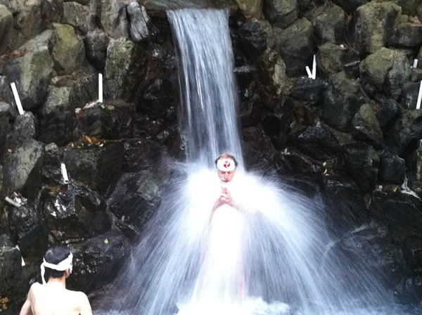
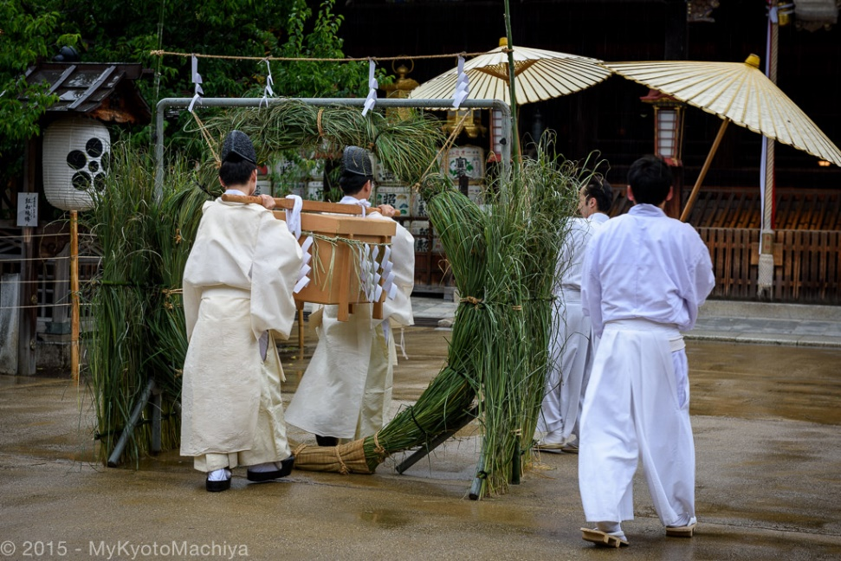
Purification
Misogi ascetic practice of purification by waterfall
Oharai purifications by branch sacred sakaki tree
Notes:
believer may stand beneath a waterfall, letting its force hit his or her shoulders and carry impurities and tensions away. Before even entering the waterfall, those seeking purification must undergo preliminary purification practices because the waterfall itself is kami. The women put on white kimonos and headbands, the men white loincloths and headbands.

Slide 43
Buddhist, Daoist, and Confucian influences (1 of 2)
What elements of Confucianism and Buddhism have influenced Shinto?
Buddhism introduced into Japan in sixth century
Confucian ideals embedded in Japanese ethics
Confucianism used by government to control people in Edo period (1603–1868)
Notes:
Confucian ideals became embedded in Japanese ethics, particularly with reference to comfortable human relationships. The striking politeness and respectful and helpful behavior of many contemporary Japanese people may be traced back to those Confucian ideals. But Confucian ideals were also used by the government to control and pacify the people, especially during the Edo period (1603–1868). Since the Confucian model was regarded as the best way to stabilize the country, Confucian scholars were sponsored.
Buddhism has become an integral part of Japan’s religious landscape. Buddhist monks of medieval times tried to convince the Japanese that the kami were protectors of Buddhist temples, and then that they were actually manifestations of the Buddha essence. During the Heian period (794–1192) Buddhism and reverence for the kami merged to a considerable extent. During the Kamakura period (1192–1333), Shinto became more self-conscious and systematic, and the idea was promoted that the kami were the original essence and the Buddhas and bodhisattvas their manifestations. The two religions continued to be closely interwoven in many ways until the nineteenth century, when the Meiji government promoted its version of Shinto as part of its program of nationalistic revival. In the Meiji Restoration, Shinto was distinguished from Buddhism, which was denounced for its foreign origins.

Slide 44
Buddhist, Daoist, and Confucian influences (2 of 2)
Chinese folk religion (practices including worship of spirits, spirit possession, divination, and oracles)
Chinese yin–yang theories, and elements of Daoism and Confucianism have also become blended with whatever kami practices might have existed since prehistory in Japan
“The influence of Chinese religion in East Asia is so prominent that the whole region may well be regarded as a single ‘Chinese religio-cultural sphere.’
Notes:
Buddhism has become an integral part of Japan’s religious landscape. Buddhist monks of medieval times tried to convince the Japanese that the kami were protectors of Buddhist temples, and then that they were actually manifestations of the Buddha essence.

Slide 45
State Shinto
Why has Shinto been so closely tied to Japanese nationalism?
Meiji regime (1868-1912): Shinto was basis of government
Since the seventh century, emperor viewed as offspring of Amaterasu
Members of imperial family visited Ise Shrine
Consulted spirits on matters of importance
“State Shinto” administered by government officials, not priests
Notes:
The Meiji regime took steps to promote Shinto as the spiritual basis for the government. The state cult, amplifying the Japanese traditions of ancestor veneration, had taught since the seventh century ce that the emperor was the offspring of Amaterasu, the sun goddess
t had been customary for members of the imperial family to visit the great shrine to the sun goddess at Ise to consult the supreme kami on matters of importance. But Emperor Meiji was the first emperor ever to go there. He decreed that the way of the kami should govern the nation. This way, now referred to as “State Shinto,” was administered by government officials rather than Shinto priests, whose objections were silenced, and many of the old rituals were suppressed. State Shinto became the tool of militaristic nationalists as a way to enlist popular support for the throne and the expanding empire.

Slide 46
State Shinto
Why has Shinto been so closely tied to Japanese nationalism?
Nationalists idealized Japan’s ancient “Shinto” past
Japan projected as a large family with emperor as father
Emperor Hirohito (1901–1989): renounced divine status
Notes:
nationalists idealized Japan’s ancient “Shinto” past, using Confucian-style ancestor worship to promote reverence for historical emperors and people who had died for their country. Japan was projected as a large family with the emperor as its benevolent father, ruling under the protection of the kami.
As “ancient traditions” were invented, hereditary lineages of shrine priests were disbanded and replaced by state-appointed priests who would perform standardized rituals on behalf of the emperor
Buddhist authorities insisted that “Shinto” was not a real religion; shrines were only places for the performance of rituals. Thus, in 1882, shrine priests were barred from carrying on any “religious” activities, including preaching and holding funerals. And in 1906, thousands of local shrines were consolidated, with the goal—not fully implemented—of having only one shrine in each area as a platform for conducting national imperial ceremonies
he emperor officially renounced his hereditary claim to being divine in order to protect the monarchy from being totally disbanded by the occupying powers

Slide 47
“Sect Shinto”
What is “Sect Shinto”?
In rural areas, female shamans fell into trances; kami spoke through them
Oomoto: New movement
Revelations given to Madam Nao Deguchi, an illiterate widow possessed by a kami
Attracted 9 million followers during Meiji regime
New god Oomoto “Great Source”
Today: universalist approach, recognizing founders of other religions as kami
Notes:
With modern industrialization and urbanization, worship for generations at the same village shrines further declined. And the designation of shrines as “non-religious” lingered, with spiritual practices such as divination, healing, and communication with ancestors looked down on as superstitions
certain women had long been acting as shamans by falling into trances, in which the kami would speak through them. Some of these shamanistic women developed a following of their own, leading to movements that were labeled “Sect Shinto” by the Meiji regime.
when she was reportedly possessed by the previously little known kami Ushitora no Konjin in 1892. Some 200,000 pages of revelations, which Madame Deguchi received by automatic writing, criticized the “beastly” state of humanity, with:
survived two periods of severe persecution during the Meiji regime. Its followers study traditional Japanese arts, such as calligraphy, ceramics, and Noh drama, with the idea that artistic creation can be a way of cleaning mind and heart. Spiritual leadership of the organization is always passed down through women of Madame Deguchi’s lineage, because of her assertion that women are more spiritually open.

Slide 48
Shinto today (1 of 2)
What rituals and ceremonies are practiced in contemporary Shinto?
Shinto commonly practiced in Hawai’i and Brazil
Threats to institutionalized Shinto
Reaction to World War II
Elimination of imperial mythology
Desire for modernization
Notes:
Shinto beliefs and practices are common only in Hawai’i and Brazil, because many Japanese have settled there. Most Japanese people who visit shrines and pray to the kami do not even think of themselves as Shinto adherents. This label is applied mostly by the priestly establishment.
Most Japanese people who visit shrines and pray to the kami do not even think of themselves as Shinto adherents. This label is applied mostly by the priestly establishment. reaction to the horrors of World War II, the elimination of the imperial mythology of State Shinto, and a desire for modernization threatened institutionalized Shinto. After the war, the Japanese Teachers Association began teaching rejection of the imperial family, of Japanese history, and also of the beliefs and practices that had become associated with Shinto.
But the shrines remain and are visited by more than eighty million Japanese at New Year. People often visit more as tourists than as believers, but many say they experience a sense of spiritual renewal when they visit a shrine. Longestablished households still have their kami shelf, often next to the Buddhist family altar, which combines tablets memorializing the dead with scrolls or statues dedicated to a manifestation of the Buddha.
Shinto priest Hitoshi Iwasaki explains this eclectic approach:
People come to the shrines. They gather there because these are sacred places from ancient times where people have come to pray. And other people want to go where people are gathered, so some of the shrines become vacation places, surrounded by souvenir shops. Many come to Shinto shrines and pray Buddhist prayers. Why not? Buddha is one of the kami. Everything has kami.

Slide 49
Shinto today (1 of 2)
What rituals and ceremonies are practiced in contemporary Shinto?
Shinto symbolism of Japanese flag
Shinto shrines
80 million visitors at New Year
More visitors are tourists than believers
Notes:
The Japanese national flag—a red circle on a white background—became a symbol of the past, although its symbolism transcends history. The red circle signifies the rising sun and the white background purity, righteousness, and national loyalty. But the shrines remain and are visited by more than eighty million Japanese at New Year. People often visit more as tourists than as believers, but many say they experience a sense of spiritual renewal when they visit a shrine.
Longestablished households still have their kami shelf, often next to the Buddhist family altar, which combines tablets memorializing the dead with scrolls or statues dedicated to a manifestation of the Buddha.
Shinto priest Hitoshi Iwasaki explains this eclectic approach:
People come to the shrines. They gather there because these are sacred places from ancient times where people have come to pray. And other people want to go where people are gathered, so some of the shrines become vacation places, surrounded by souvenir shops. Many come to Shinto shrines and pray Buddhist prayers. Why not? Buddha is one of the kami. Everything has kami.

Slide 50
Shinto today (1 of 2)
What rituals and ceremonies are practiced in contemporary Shinto?
People come to the shrines. They gather there because these are sacred places from ancient times where people have come to pray. And other people want to go where people are gathered, so some of the shrines become vacation places, surrounded by souvenir shops. Many come to Shinto shrines and pray Buddhist prayers. Why not? Buddha is one of the kami. Everything has kami.
Shinto priest Hitoshi Iwasaki
Notes:
The Japanese national flag—a red circle on a white background—became a symbol of the past, although its symbolism transcends history. The red circle signifies the rising sun and the white background purity, righteousness, and national loyalty. But the shrines remain and are visited by more than eighty million Japanese at New Year. People often visit more as tourists than as believers, but many say they experience a sense of spiritual renewal when they visit a shrine.
Longestablished households still have their kami shelf, often next to the Buddhist family altar, which combines tablets memorializing the dead with scrolls or statues dedicated to a manifestation of the Buddha.
Shinto priest Hitoshi Iwasaki explains this eclectic approach:
People come to the shrines. They gather there because these are sacred places from ancient times where people have come to pray. And other people want to go where people are gathered, so some of the shrines become vacation places, surrounded by souvenir shops. Many come to Shinto shrines and pray Buddhist prayers. Why not? Buddha is one of the kami. Everything has kami.

Slide 51
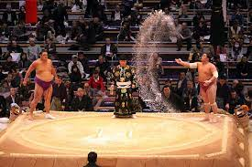
Shinto today (2 of 2)
Disasters of 2011 caused citizens to urge for more respect for nature
Sumo wrestling: many Shinto elements
Notes:
earthquake and tsunami of 2011
the Shinto establishment offered rites in their Tokyo headquarters seeking the kami’s help in quickly restoring the devastated areas, as well as sending young shrine priests out to gather funds for disaster relief. In the chaos and distress following the disaster, many people took refuge in shrines that survived. Many devastated towns and villages revived old festivals for dealing with seasonal damage by winds and floods. Ritual performances known as kagura mirrored the festivities said to have been used to lure Amaterasu out of the cave. Participating in such shrine festivals helped to rebuild community bonds, comfort the mourners, and develop the feeling that the cosmos was being restored in the wake of chaos.

Slide 52
Shinto today (2 of 2)
Yasukuni Shrine: controversy over honoring war criminals
Shinto shrines: Brazil, Canada, France, North and South Korean, the Netherlands, Taiwan, and the United States
Notes:
he Shinto establishment offered rites in their Tokyo headquarters seeking the kami’s help in quickly restoring the devastated areas, as well as sending young shrine priests out to gather funds for disaster relief. In the chaos and distress following the disaster, many people took refuge in shrines that survived. Many devastated towns and villages revived old festivals for dealing with seasonal damage by winds and floods. Ritual performances known as kagura mirrored the festivities said to have been used to lure Amaterasu out of the cave. Participating in such shrine festivals helped to rebuild community bonds, comfort the mourners, and develop the feeling that the cosmos was being restored in the wake of chaos.

Slide 53
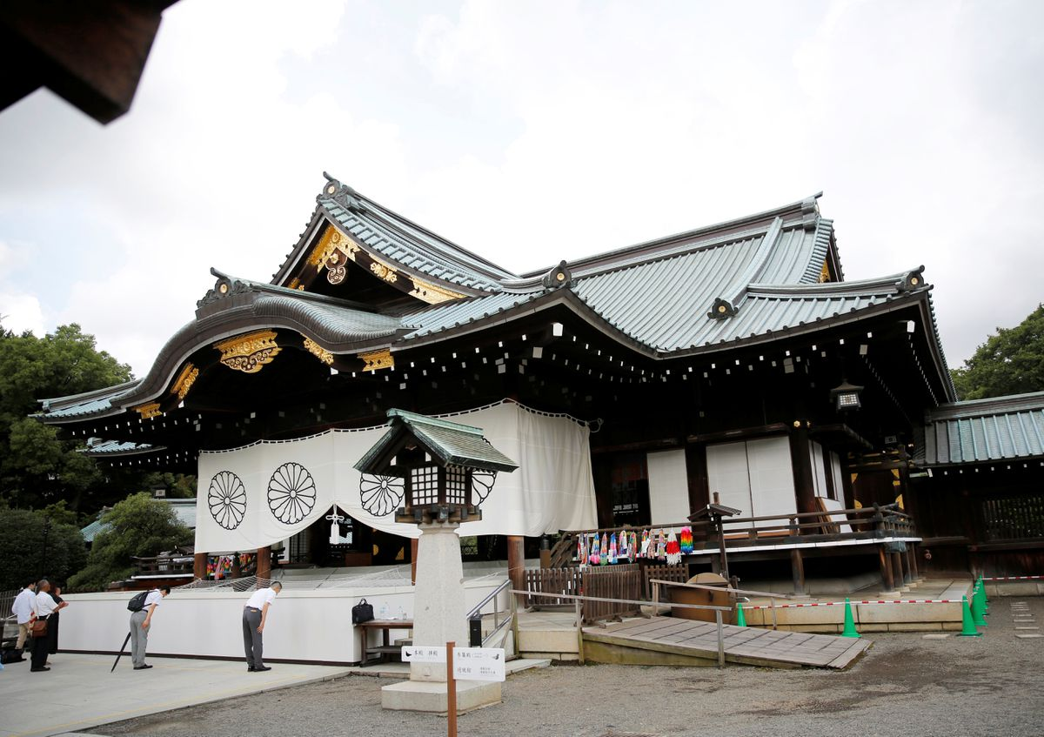
Yasukuni Shrine “Peaceful Country”
Controversy over honoring war criminals
Dedicated during the Meiji Restoration in honor of those who have given their lives in war
Written records of some 2.5 million people who died in various conflicts are enshrined
Notes:
It was dedicated during the Meiji Restoration in honor of those who have given their lives in war for the sake of Japan, with the idea that they died to preserve peace in Japan. Yasukuni means “peaceful country.” Written records of some 2.5 million people who died in various conflicts are enshrined therein. The political controversy concerns the 1978 inclusion of fourteen Japanese leaders from World War II who had been classified as Class A war criminals by an Allied tribunal. When highly visible political figures—including Japanese prime ministers—have paid their respects at the shrine, there has been strong criticism from abroad.

Slide 54
Yasukuni Shrine “Peaceful Country”
Political controversy concerns the 1978 inclusion of 14 Japanese leaders from World War II who had been classified as Class A war criminals by an Allied tribunal
When highly visible political figures—including Japanese prime ministers—have paid their respects at the shrine, there has been strong criticism from abroad.
Notes:
It was dedicated during the Meiji Restoration in honor of those who have given their lives in war for the sake of Japan, with the idea that they died to preserve peace in Japan. Yasukuni means “peaceful country.” Written records of some 2.5 million people who died in various conflicts are enshrined therein. The political controversy concerns the 1978 inclusion of fourteen Japanese leaders from World War II who had been classified as Class A war criminals by an Allied tribunal. When highly visible political figures—including Japanese prime ministers—have paid their respects at the shrine, there has been strong criticism from abroad.

Slide 55
Yasukuni Shrine “Peaceful Country”
China and Korea regard the shrine as a symbol of militarism and ultranationalism, and the prime ministers’ visits as disregard for the principle of separation of religion from the state.
Notes:
It was dedicated during the Meiji Restoration in honor of those who have given their lives in war for the sake of Japan, with the idea that they died to preserve peace in Japan. Yasukuni means “peaceful country.” Written records of some 2.5 million people who died in various conflicts are enshrined therein. The political controversy concerns the 1978 inclusion of fourteen Japanese leaders from World War II who had been classified as Class A war criminals by an Allied tribunal. When highly visible political figures—including Japanese prime ministers—have paid their respects at the shrine, there has been strong criticism from abroad.

Slide 56
Shinto today (2 of 2)
Shinto shrines: Brazil, Canada, France, North and South Korean, the Netherlands, Taiwan, and the United States
Some Shinto adherents now explain their path as a universal natural religion, rather than an exclusively Japanese phenomenon
Try to explain the way of harmony with the kami to interested non-Japanese, without striving for conversions
Signs of a return to the central theme of Shinto as harmony with nature
New attempts to teach children the thousands-of-years-old rice-cultivation ceremony, and with it, values such as co-existence and “co-prosperity” with the natural environment and with each other
Notes:
he Shinto establishment offered rites in their Tokyo headquarters seeking the kami’s help in quickly restoring the devastated areas, as well as sending young shrine priests out to gather funds for disaster relief. In the chaos and distress following the disaster, many people took refuge in shrines that survived. Many devastated towns and villages revived old festivals for dealing with seasonal damage by winds and floods. Ritual performances known as kagura mirrored the festivities said to have been used to lure Amaterasu out of the cave. Participating in such shrine festivals helped to rebuild community bonds, comfort the mourners, and develop the feeling that the cosmos was being restored in the wake of chaos.

